Slide 1
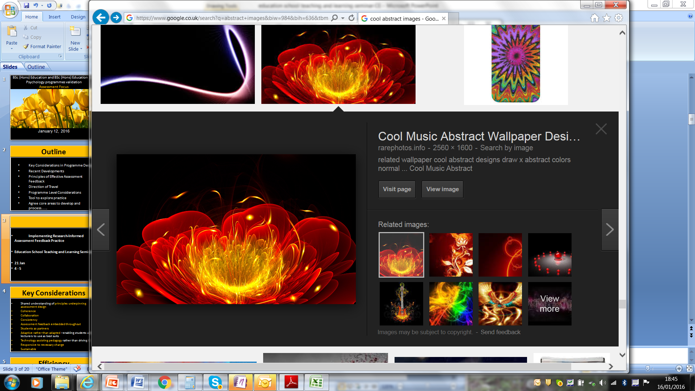
Enhancing Effective Assessment and Feedback
Cool Music Abstract Wallpaper Designs - Rare photos rarephotos.info2560 × 1600
Professional Practice in Health Sciences; Centre for Innovation & Leadership in Health Sciences
January 19, 2016

Slide 2
Sessions
19 Jan Room 0013 Building 45
5 February Room 0045 Building 45
19 February Room 0045 Building 45

Slide 3
Focus on Assessment
How can we maximise our effectiveness
Overview of University direction of travel
Review sharing of good practice mechanisms
Agree key principles underpinning assessment feedback practice
Can (EAT) evaluation tool help to explore dimensions of assessment feedback practice?
Agree immediate priorities
Agree longer term priorities in informing programme design

Slide 4
Organisation
10 – 11 Overview of current context and
considerations
11.00 – 11.20 BREAK
11.20 – 1.30 Work in groups on immediate and longer term priorities
1.30 – 2.00 Agree immediate actions and areas of consensus
Longer term aims ......
NEXT STEPS..........

Slide 5
Key Considerations 1
Shared understanding of principles underpinning assessment design
Coherence
Collaboration
Consistency
Assessment feedback embedded throughout

Slide 6
Key Considerations 2
Students as partners
Adaptive rather than adapted –enabling students and lecturers to use as best suits
Technology assisting pedagogy rather than driving it
Responsive to necessary change
Sustainable

Slide 7
Efficiency
    Integrated Designs
    Marginal Gains: Where is effort best placed?
How can we maximise impact of what we do??
How can technology best support us?

Slide 8
http://rer.sagepub.com/content/83/1/70.full.pdf+html
    Principles Underpinning Assessment Feedback Design

Slide 9
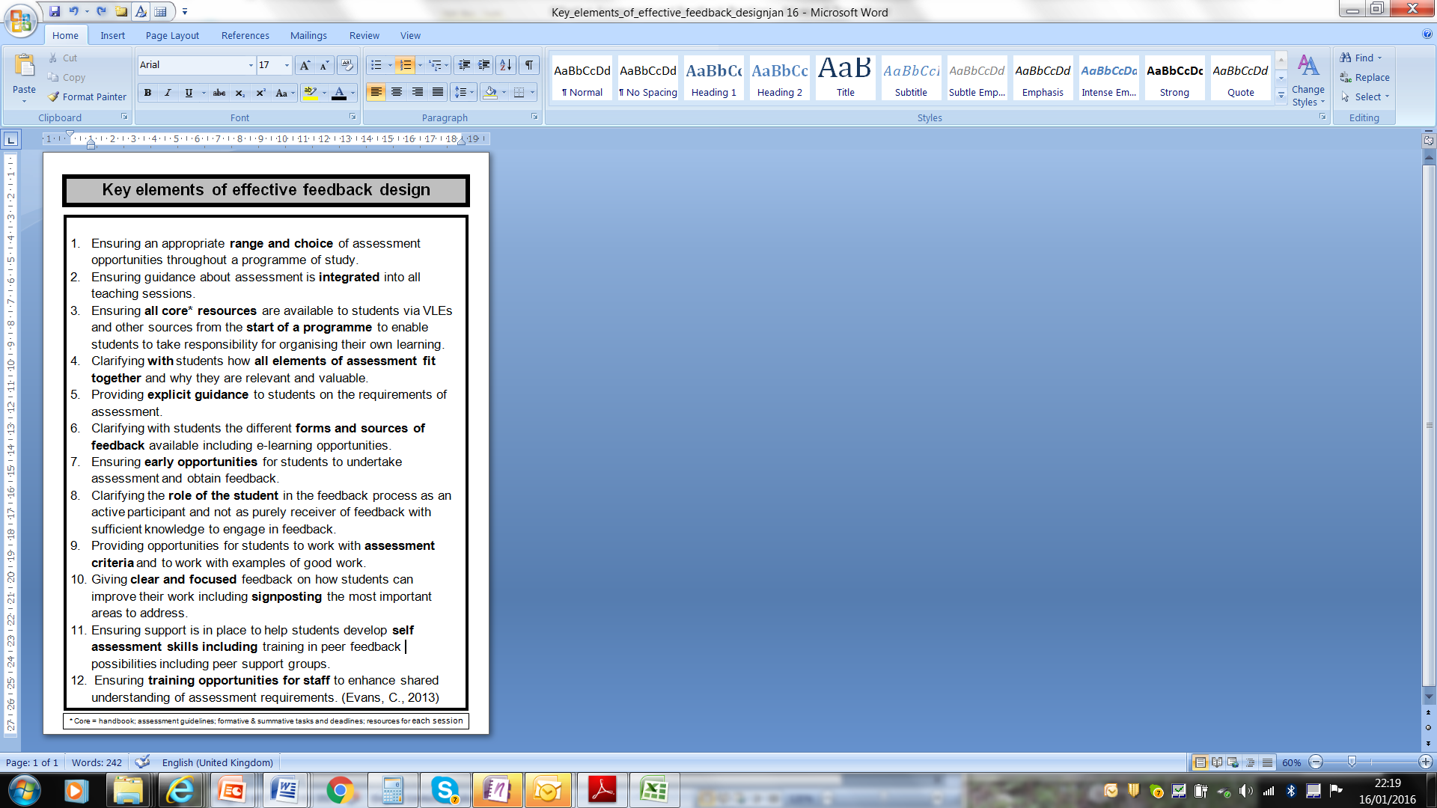

Slide 10
Focus on Fitness for Purpose
Programme Level Assessment
Supporting Innovation
Rationalise Learning Outcomes and Assessment
Reduce the number of modules; reduce volume of assessment?
Be clear about the base line of student entitlement
Consistency in approaches to feedback giving
Sharing resources and good practice – what are the mechanisms for doing this?

Slide 11
Specifics
Balance of formative and summative feedback
Focused Feedback (less is more)
Implement enhancements incrementally and share what is being done and why with students
Clarify what is good about what you are doing
Clarify what the students can do for themselves

Slide 12
Collaborative Practice (RAP)
Share resources and tools through a dedicated website
Develop a coherent programme of events
Organise bespoke training /peer support
Publications
Research Funding

Slide 13
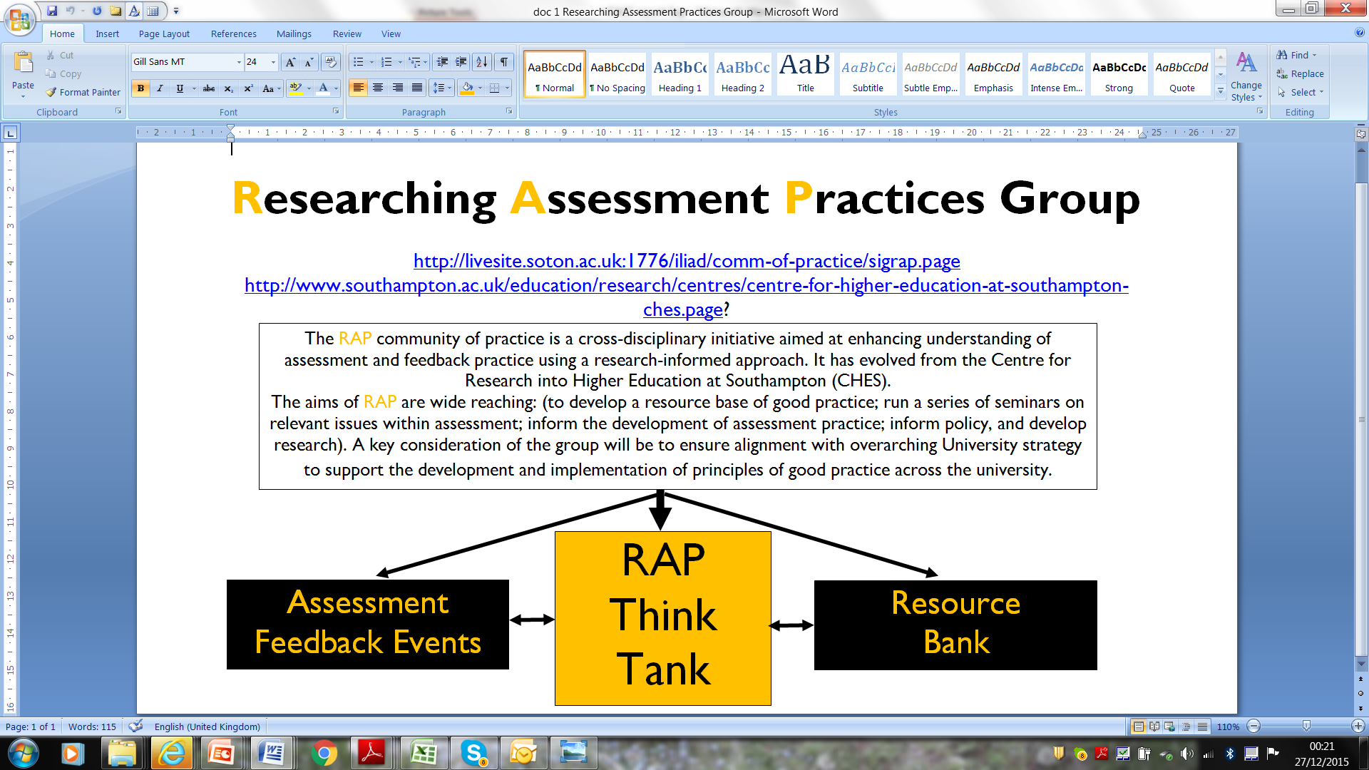
Bespoke training

Slide 14
Exploring Practice
in the workload model?

Slide 15
Assessment Practice Foci
Assessment Tool (EAT)
12 dimensions related to 3 key areas:
Assessment Literacy (AL)
Facilitating Improvements in Learning: Feeding Forward and Up (FIiL)
  Holistic Assessment Design (HAD)

Slide 16
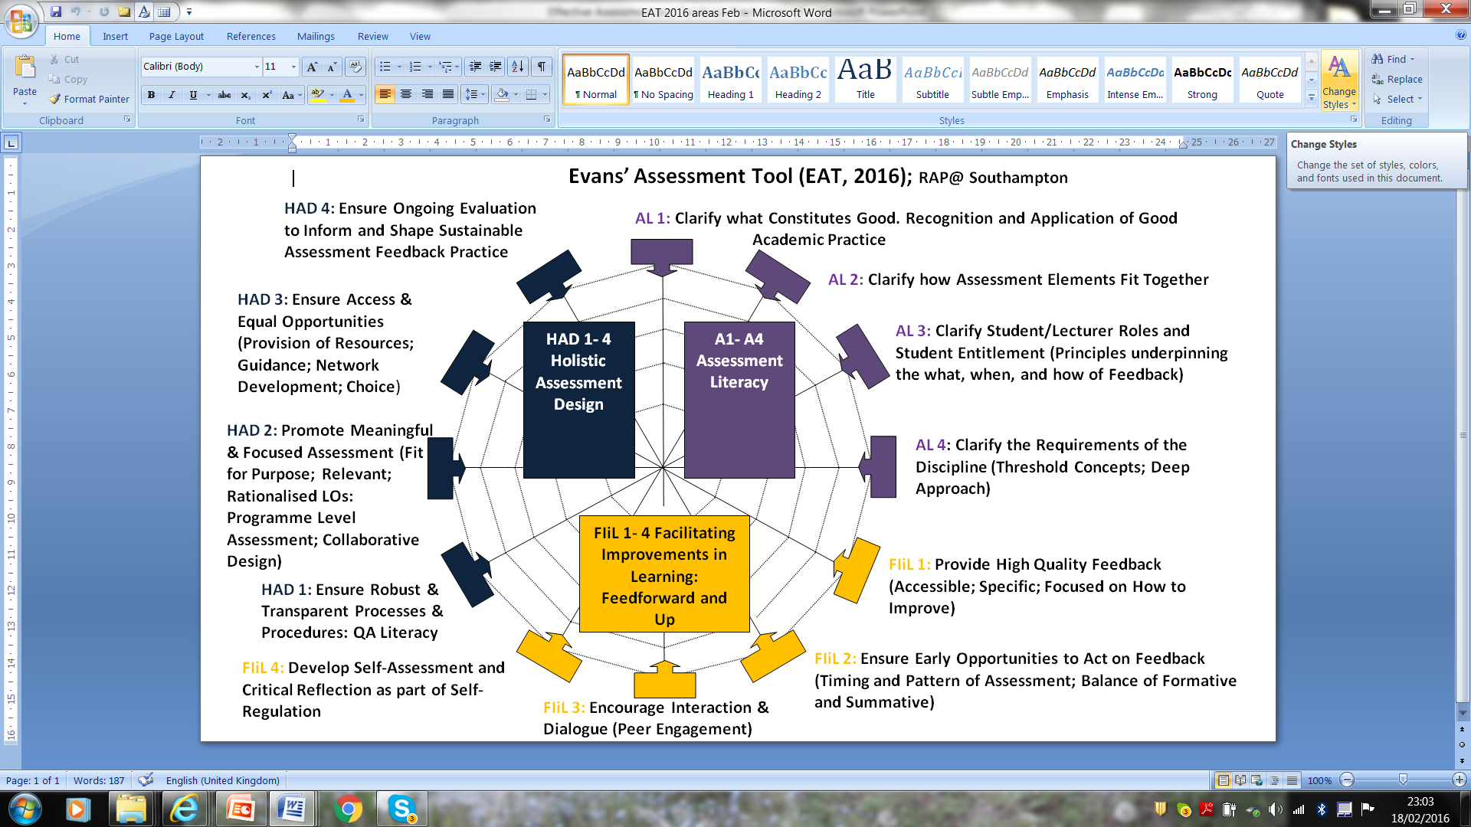

Slide 17
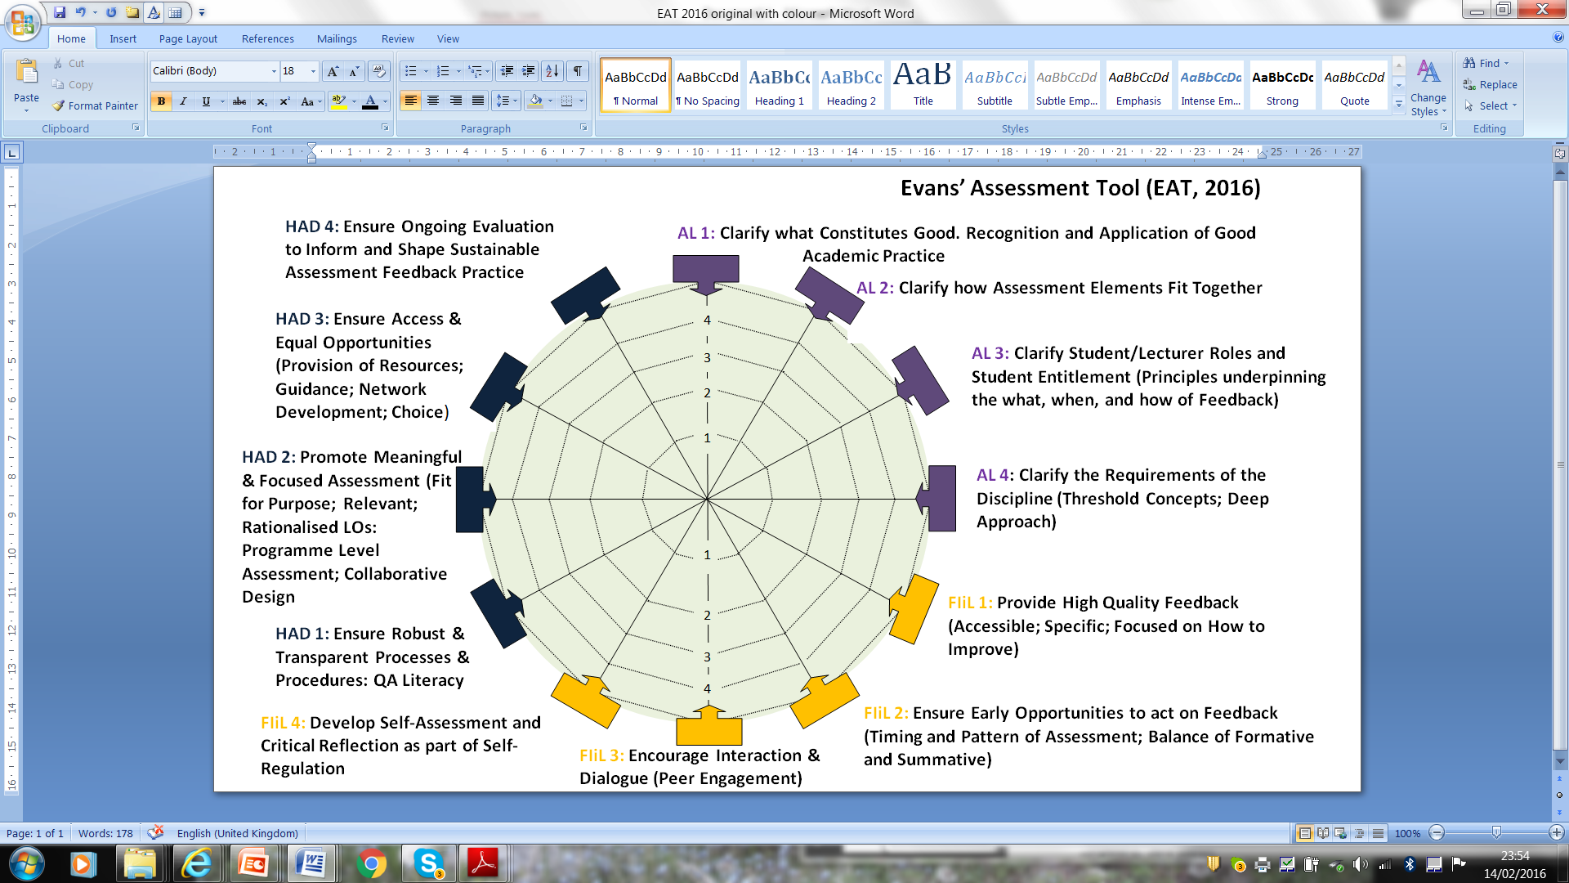

Slide 18
Where to now....
Targets for developing practice
Membership of RAP
Active RAP lead within Health Sciences and specific disciplines within HS.
Research Group looking at Assessment Feedback
Part of Leverhulme Bid on developing sustainable self-regulatory assessment practice
Bespoke support
Work with teams reconvene to look at progress and next steps?

Slide 19
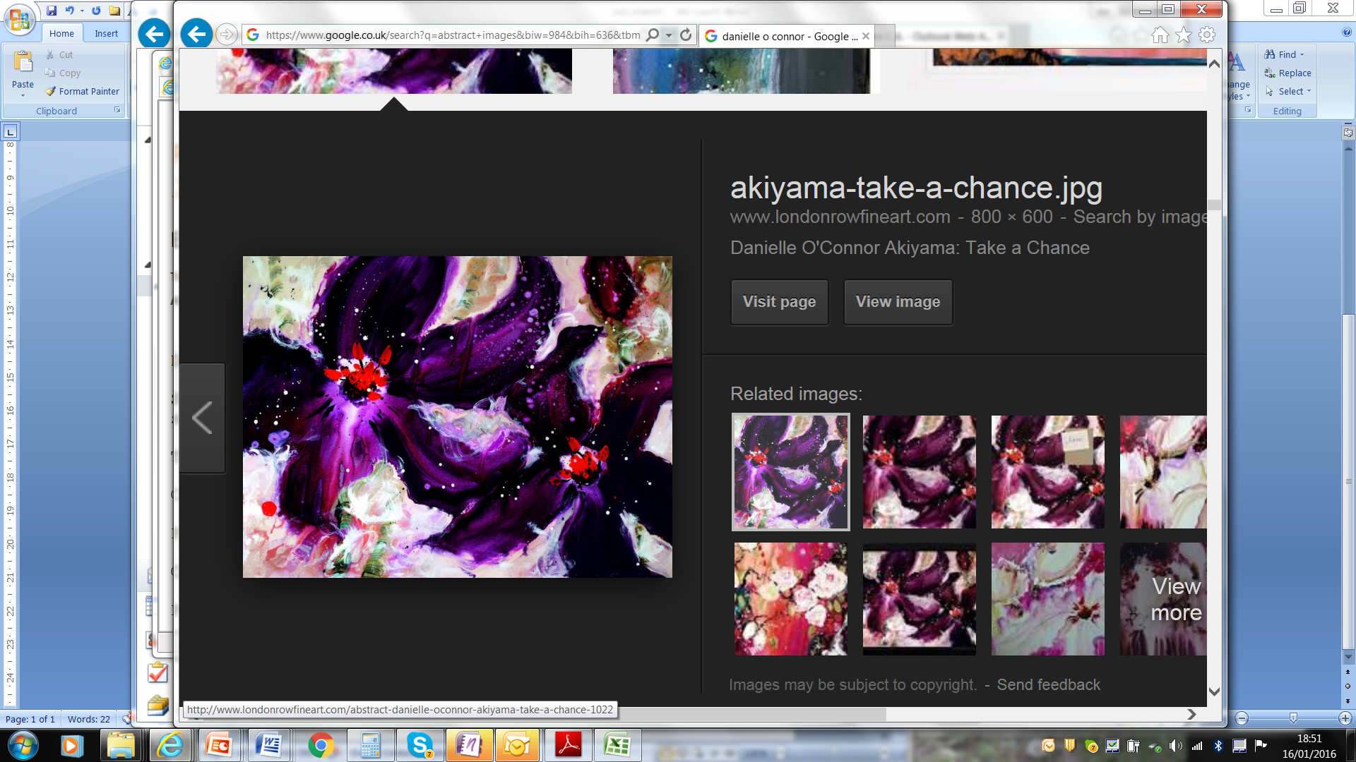
Enhancing Effective Assessment and Feedback
Contact me at c.a.evans@soton.ac.uk
January 19, 2016
D O’Connor Scarlet Symphony
D O’Connor Crossing Paradise

Slide 20
Reference Points QA
QAA
Quality Code http://www.qaa.ac.uk/assuring-standards-and-quality/the-quality-code/quality-code-part-b
Framework for Higher Education Qualifications (FHEQ)
http://www.qaa.ac.uk/publications/information-and-guidance/publication?PubID=2718#.Vns7e6tFA5s
University of Southampton
Quality Handbook: http://www.southampton.ac.uk/quality/assessment/index.page?
UoS Calendar: http://www.calendar.soton.ac.uk/

Slide 21
Feedback Champions
http://blog.soton.ac.uk/feedbackchampions/for-staff/

Slide 22
Reference Points HEA
HEA
Transforming Assessment in Higher Education toolkit:
https://www.heacademy.ac.uk/enhancement/toolkits/transforming-assessment-higher-education-toolkit
UK Professional Standards Framework 2011:
https://www.heacademy.ac.uk/recognition-accreditation/uk-professional-standards-framework-ukpsf

Slide 23
HEA Disciplines
Health and Social Care
https://www.heacademy.ac.uk/search/site/assessment?f[0]=im_field_discipline%3A1226

Slide 24
Reference Points Research
Evans (2013) Making Sense of Assessment Feedback on Higher Education
http://rer.sagepub.com/content/83/1/70.full.pdf+html
Waring and Evans (2015) Understanding Pedagogy http://www.amazon.co.uk
/Understanding-Pedagogy-Developing-critical-approach/dp/041557174X

Slide 25
Reference Points Research
Evans (2015) Personal Learning Styles Pedagogy
https://www.heacademy.ac.uk/sites/default/files/carol_evans_report.pdf
Evans, Muijs & Tomlinson(2015) Student Engagement
https://www.heacademy.ac.uk/sites/default/files/engaged_student_learning_high-impact_pedagogies.pdf
Innovating Pedagogy OU 2015 report
http://proxima.iet.open.ac.uk/public/innovating_pedagogy_2015.pdf

Slide 26
Changing emphasis in NSS / Engagement Surveys
^{Challenge}
My course has challenged me to achieve my best
The teaching has encouraged me to think about the course content in greater depth
OR
My course has provided me with opportunities to analyse ideas, concepts or experiences in depth
The course has encouraged me to apply what I have learnt to practical problems or new situations
My course has enabled me to bring information and ideas together from different topics to solve problems.

Slide 27
Changing emphasis in NSS / Engagement Surveys
^{Feedback}
7. Feedback on my work has been prompt timely.
8. I have received detailed helpful comments on my work.
Student Voice
Staff appear to value the course feedback given by students.
I am clear about how students’ comments on the course have been acted on.
I have had enough opportunities to provide feedback on this course.
On this course, students' ideas for improvement are taken seriously.

Slide 28
Changing emphasis in NSS / Engagement Surveys
Learning community/collaborative learning
I do not feel part of a group of students and staff committed to learning.
I have not been encouraged to talk about academic ideas with other students.
I haven’t had opportunities to work jointly with other students on my course.

Slide 29


https://www.heacademy.ac.uk/resource/engaged-student-learning-high-impact-strategies-enhance-student-achievement

Slide 30

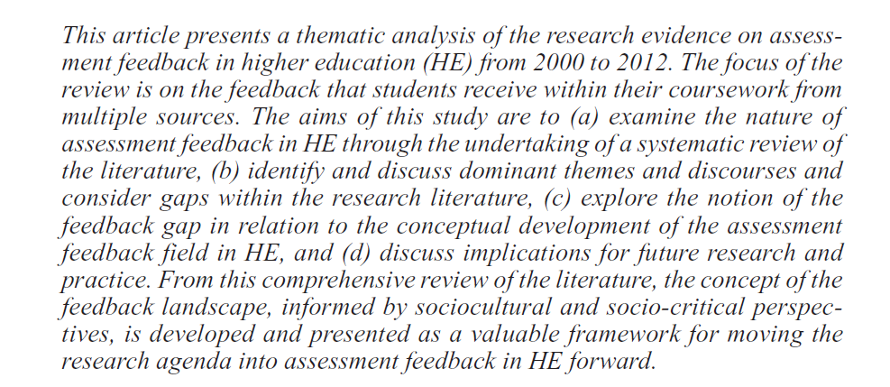
http://rer.sagepub.com/content/83/1/70

Slide 31
Future Events
Assessment Lunch Time events
10 March
21 April
26 May
24 June
29 September

